Slide 1
“mapping” the controversy
using locative media to visualize and present research

Slide 2
Learning Objectives
At the start of either Rhetoric 306 and 309, it’s crucial that students (1) determine if a topic corresponds to a current controversy and (2) identify major players. This lesson plan helps students meet these course-specific goals, alongside these boarder goals:
Locate, evaluate, organize, and use research material collected from multiple sources, including library databases
Use locative media to present research

Slide 3
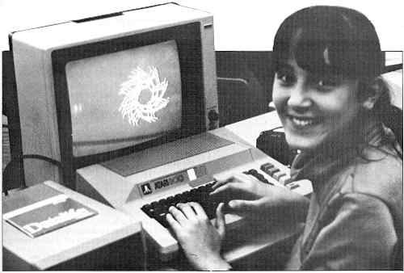
Necessary Tools
Google account (UT Mail account will work)
Computer
Access to research database(optional)
1-2 in-class work days (depending on if you require students to locate sources outside of class)
Google Earth plug-in (optional)
Notes:
If your student is working on a Texas-specific controversy, they may opt to use a news-paper specific database (e.g., access the Houston Chronicle through UT’s library website) or, if it’s current, go directly to a newspaper’s website (e.g., the Texas Tribune, which puts together resources on a particular issue in a really easy-to-use format)
You don’t need a plug-in to create or share tours, but the if you want your tour to be extra cool you’ll want to plug in (the tour we’ll show you today does not involve a plug in)

Slide 4
Competencies
How to conduct research using databases
How to identify an argument as it relates to a specific controversy

Slide 5
Step 1: Collect data
Notes:
This is probably a lesson already built-in to your 306 or 309 schedule

Slide 6
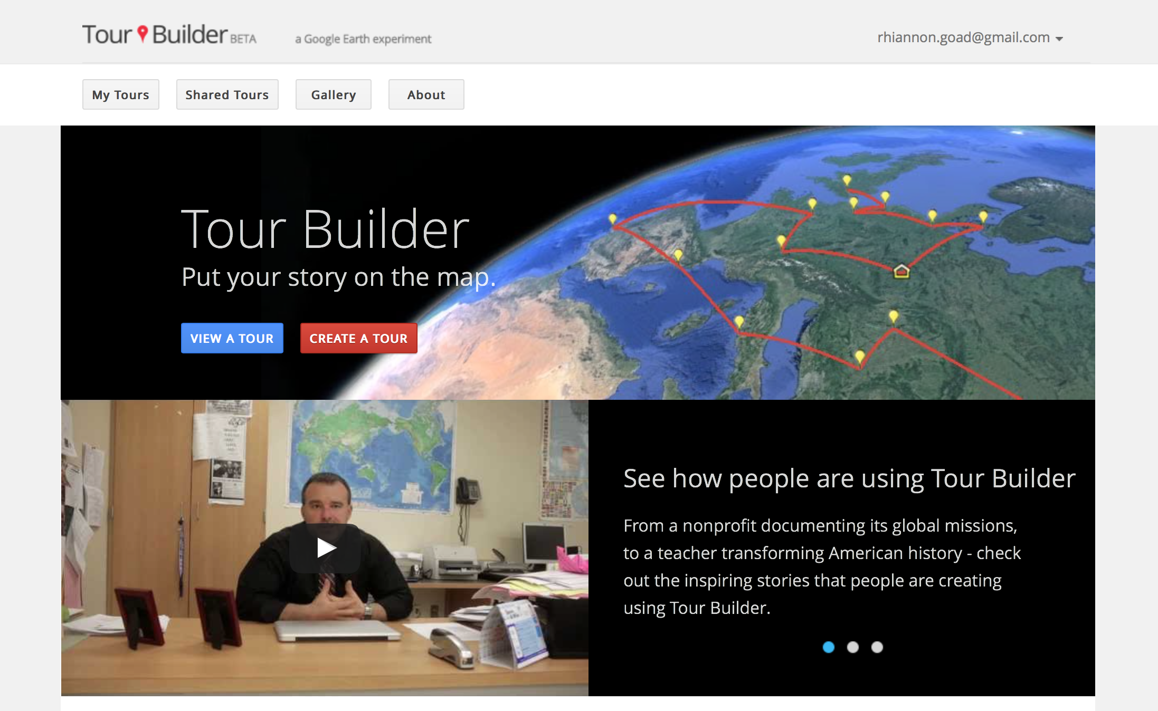
Step two: Create a Google tour
Notes:
Google Tours was originally “created to give veterans a way to record all the places that military service has taken them, and preserve their stories and memories as a legacy for their families.” Recently Google “thought it could be a useful tool for anyone with a story to tell” and “made it available to everyone.”
If you have a Google Earth plug-in, you’ll have access to some additional features (for example: 3d), but it’s not necessary. The example we’ll show you today was made without the google earth plug in.

Slide 7
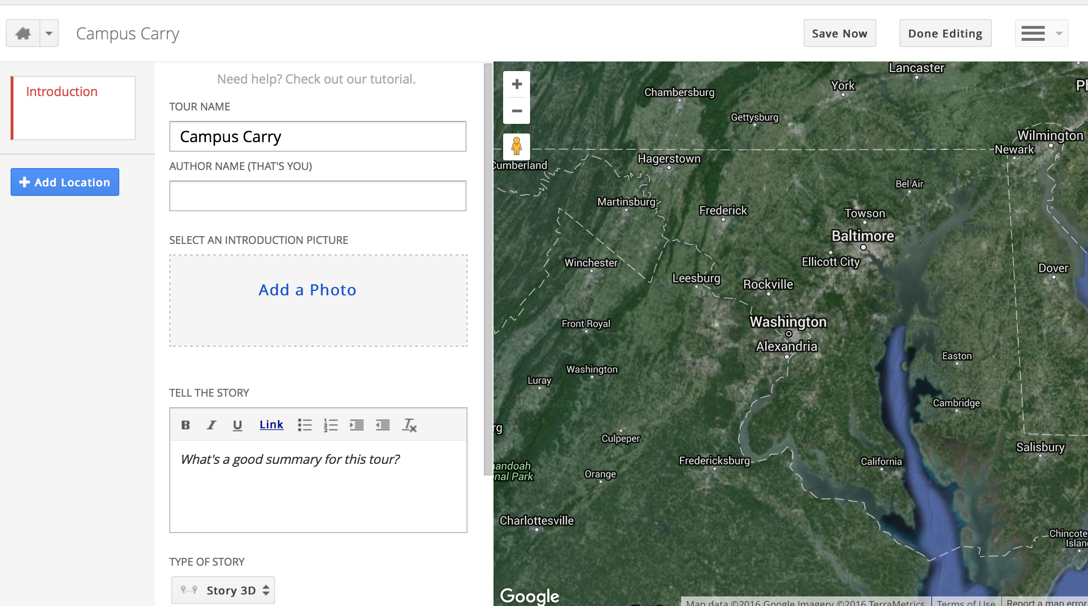
Step Three: complete fields
Notes:
If your students can use Power Point (and they can) this is super easy. You add spots on the map as you go (like “new slides”), shuffle around the side tiles when to change the order, etc.

Slide 8
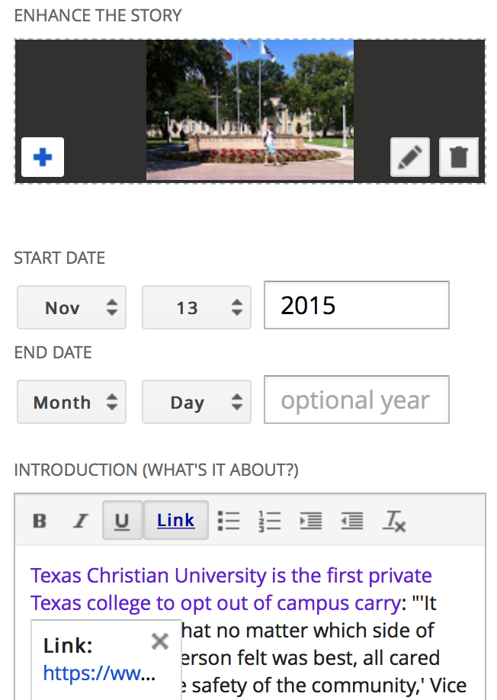
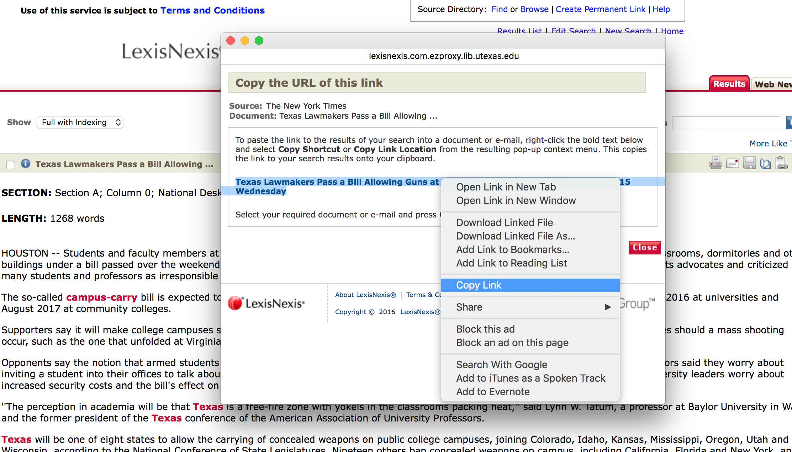
Step Three, Con’t: Link to sources
Notes:
This makes it really easy for students to keep and present their sources so that this map is something they can refer back to all semester

Slide 9
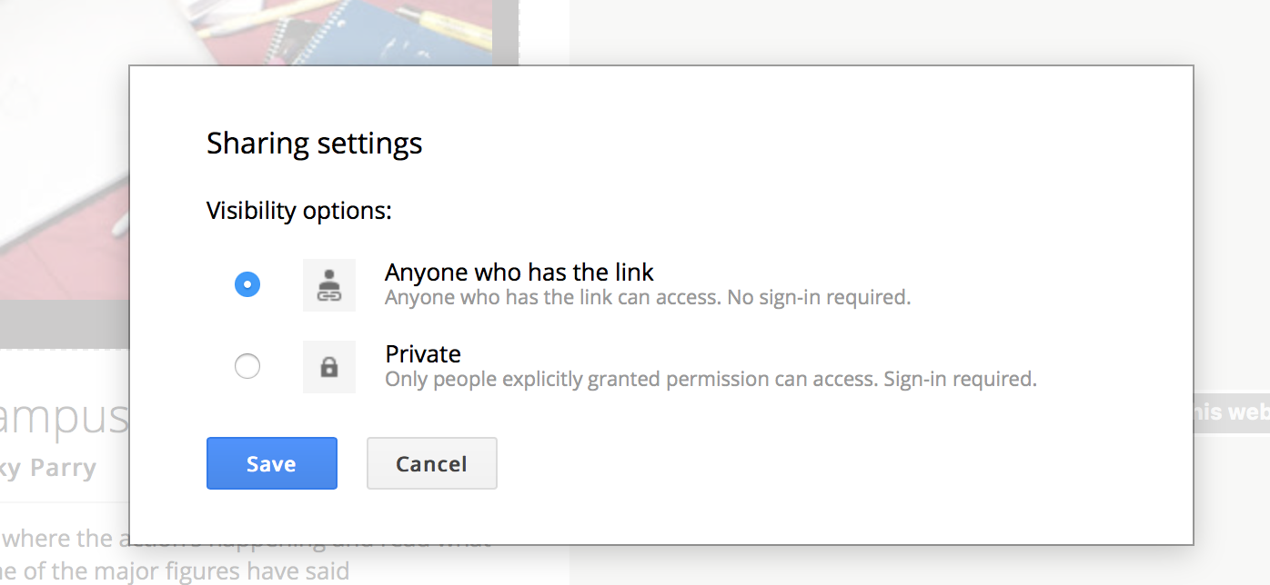
Step FOUR: Save and Share
Notes:
Share like you would a google doc

Slide 10
Example artifact: Open carry
Notes:
Rhiannon made a tour on campus carry (a controversy we expect to see a lot of student write about next year) to give you a sense of how this should work, any and all glitches are Rhiannon’s fault: https://tourbuilder.withgoogle.com/builder#play/ahJzfmd3ZWItdG91cmJ1aWxkZXJyEQsSBFRvdXIYgICAp5-gpgsM

Slide 11
Assessment
C level: all fields complete, most sources linked, contains at least six data points, identifies some key players/events but contains more than one major gap, fails to represent more than one side of the issue, only uses one publication
B level: all fields complete, incorporates more than one publication, contains at least eight data points, identifies most key players/events (one but not two gaps), represents two sides of the issue
A level : all fields complete and sources credited, represents multiple sides of the issue, incorporates a variety of sources, no major gaps, contains at least eight data points, represents more than two sides of the issue
Notes:
You could assign this as a research summary or in or out of class pre-paper 1 activity;
if you do this as a in-class activity: consider making it pass/fail, holding the c-level as the standard for passing
if your students are presenting as part of their final paper, consider giving them a chance to practice that skill and present their tour that way they can get a sense of your presentation feedback early on in the semester
We mention “gaps” here, here’s an example: for a controversy involving Planned Parenthoods in TX, neglecting to include House Bill 2 (HB2) or Whole Women’s Health vs. Hellerstedt

