Slide 1
Data Visualization Lesson Plan
Uploading a scanned image into Piktochart

Slide 2
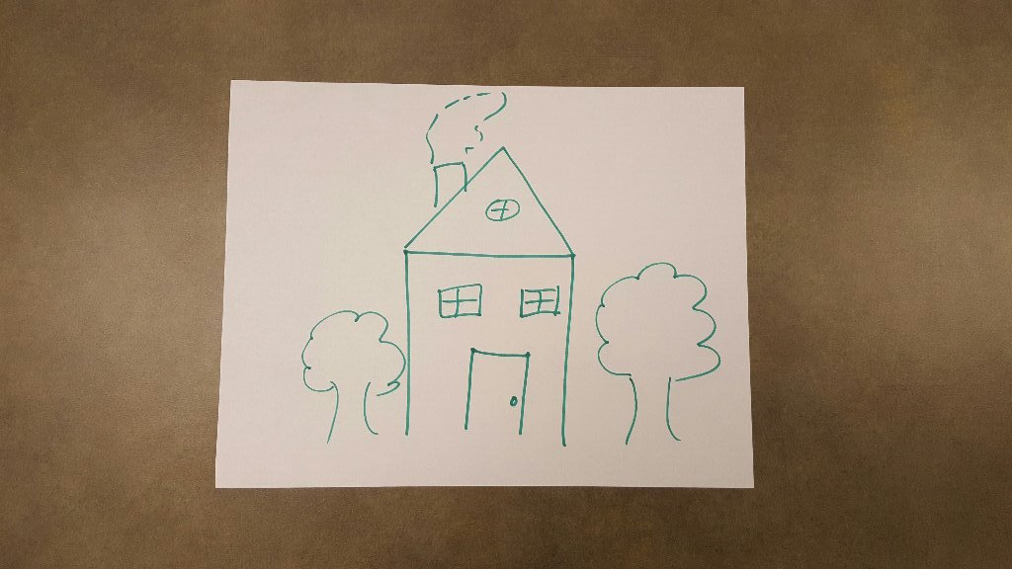
Notes:
If a student has an idea of what they want to design, but it’s too complicated for the time allotted in class. They can draw it.

Slide 3
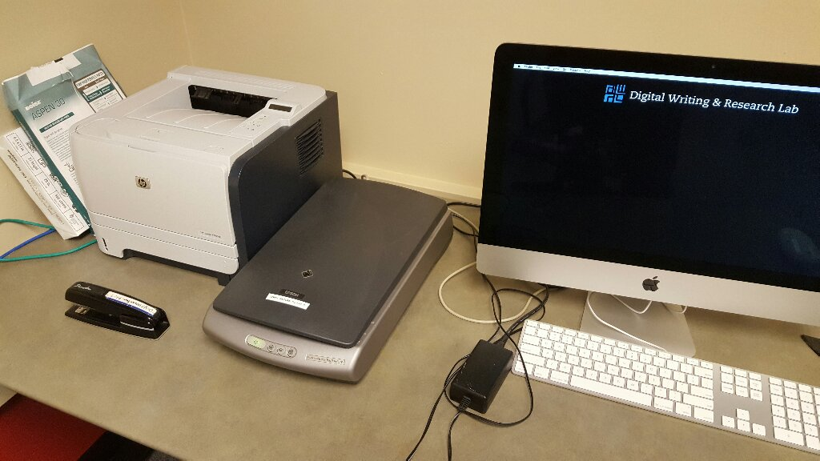
Notes:
Some DWRL classrooms have a scanner hooked up to a computer (usually next to the printer). If your classroom doesn’t have one, you can check one out.

Slide 4
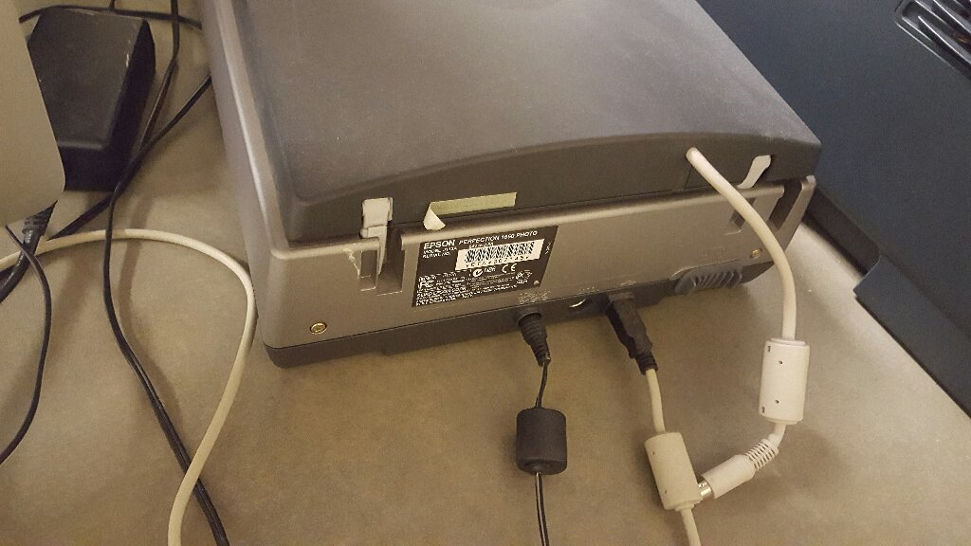
Notes:
The scanners are easy to hook up; they have a power cord and USB cord.

Slide 5
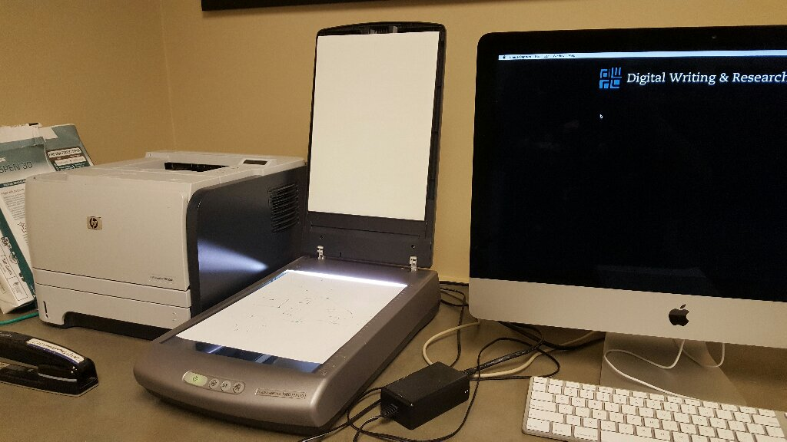
Notes:
Place the image face down on the scanner and close the lid.

Slide 6
Notes:
The built-in Apple software for scanning is Image Capture. You can find it by clicking on the “Applications” icon.

Slide 7
Notes:
The Epson scanner should show up automatically under “Devices.” If you’re using a scanner that’s already hooked up to the computer and the scanner doesn’t appear, try unplugging the USB cord and plugging it back it. Once it’s ready, just click “Scan.”

Slide 8
Notes:
The image automatically scans as a .jpeg.

Slide 9
Notes:
You can access the file in “All My Files” through the “Finder” tab. Just drag it to the desktop for easy access. Because the image is a placeholder in a draft, don’t worry about editing the photo. Students can rotate and size it in Piktochart.

Slide 10
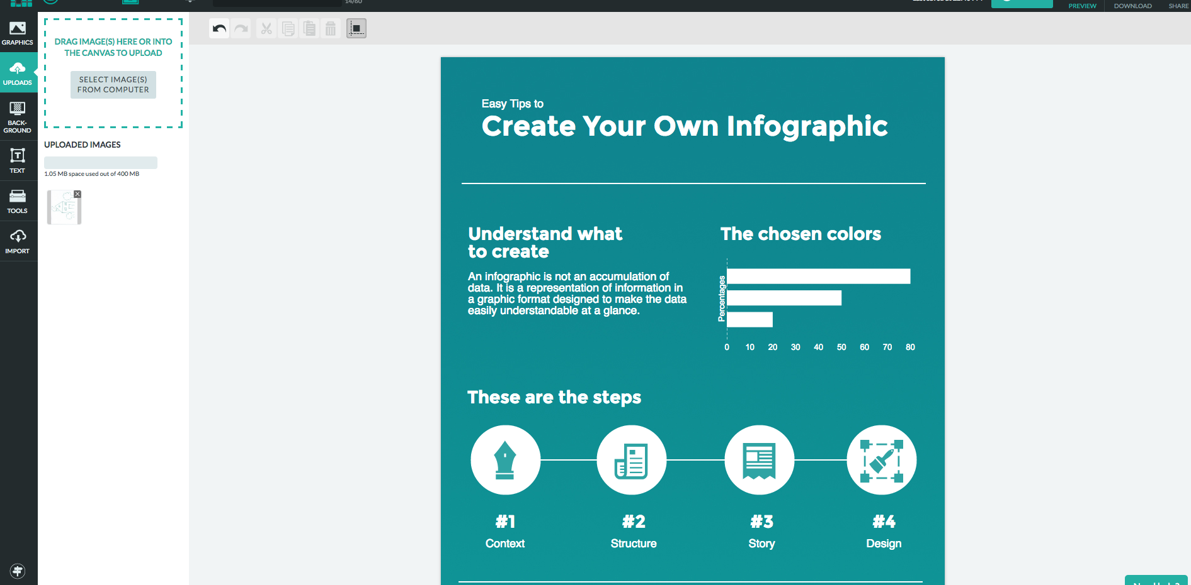
Notes:
You can email the scanned image to a student in the group. Once they save the file on their computer, they simply upload it through Piktochart.

Slide 11
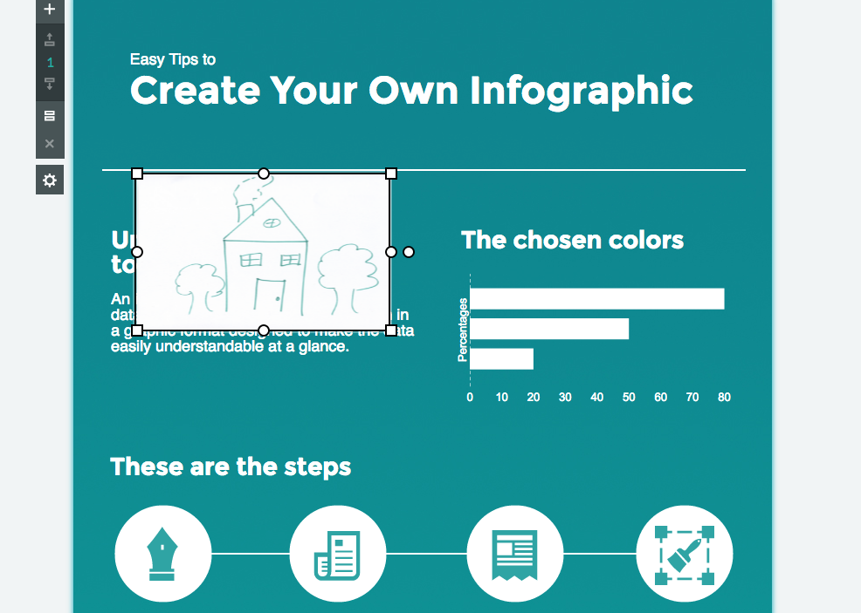
Notes:
The photo is inserted right onto the infographic. All that’s left is to click, drag, and adjust.

